Slide 1
Rockbuster Stealth LLC
Online Video Rental Service
Barbara Morrison (analyst); 7/5/2024
Ex 3.10Revenue | Tableau Public

Slide 2
Overview
Rockbuster Stealth LLC is a movie rental company that provides online video rentals.
Rockbuster is facing stiff competition from streaming services such as Netflix and Amazon Prime.
In order to stay competitive, Rockbuster wants to launch an online video rental service.

Slide 3
Objectives
Which movies contributed most/least to revenue gain?
What was the average rental duration of all videos?
Which countries are Rockbuster’s customers based in?
Where are customers with a high lifetime value based?
Do sales figures vary between geographic regions?

Slide 4
Video statistics
Average Rental Duration of All Videos = 5 days
Average rental rate = $2.98/day
Average length of videos = 115 minutes
Average replacement cost = $19.98
Most common rating = PG-13
Release Year for all movies = 2006
Total number of videos = 1000
Total number of movie genre = 16

Slide 5
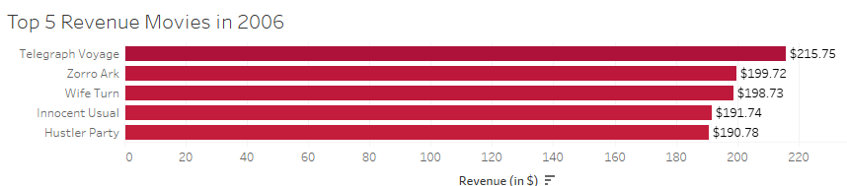
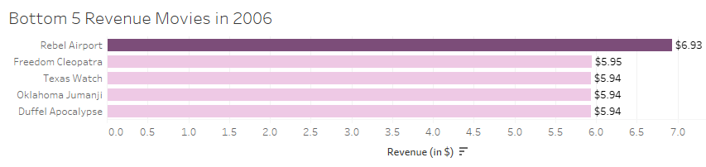
Revenue - Least/Most Popular Movies
No Revenue:
42 out of 1000 movie titles were never rented in 2006

Slide 6
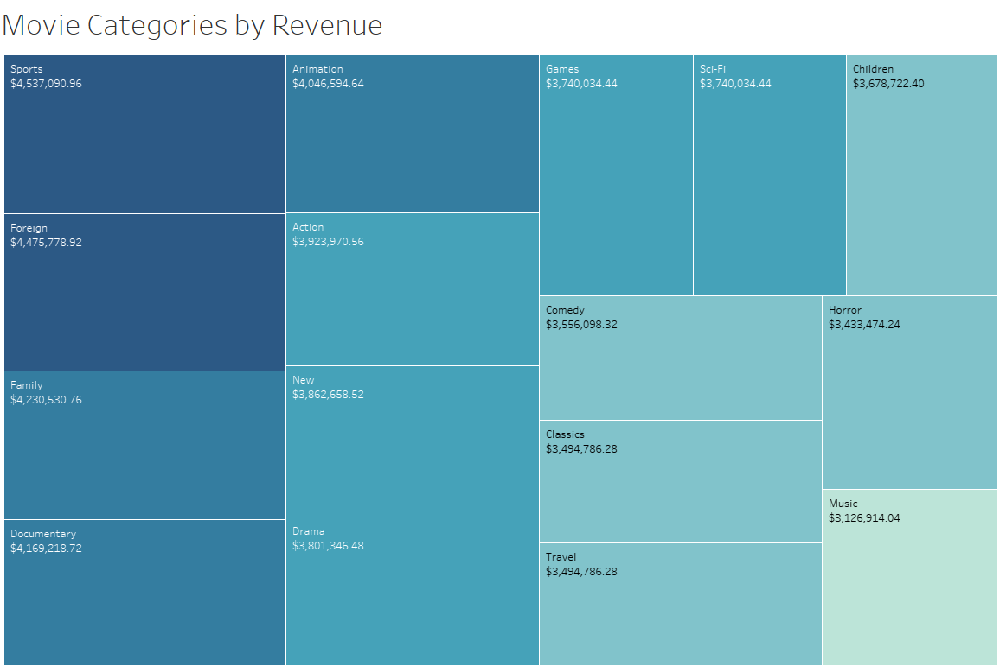
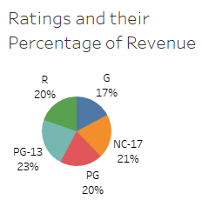

Revenue – By Genre & Ratings

Slide 7

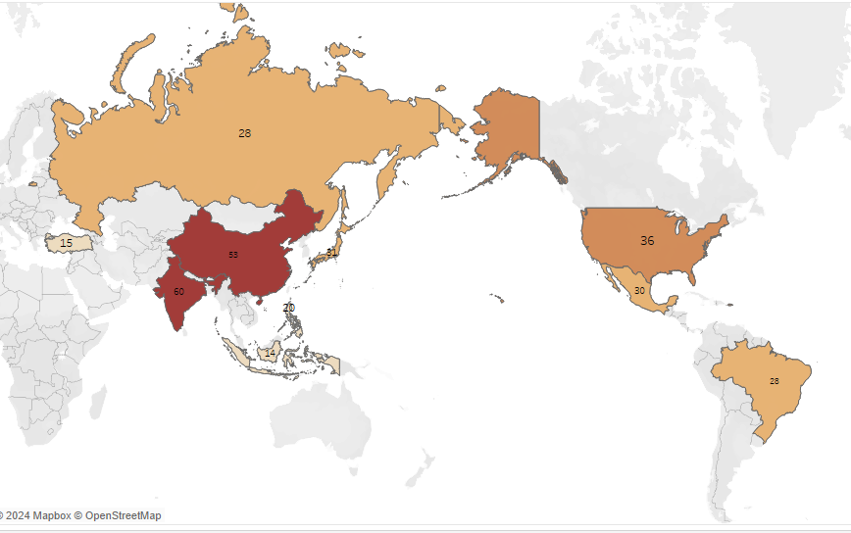
Where are Rockbuster’s customers located?
Country | Customer Count
India | 60
China | 53
United States | 36
Japan | 31
Mexico | 30
Brazil | 28
Russian Federation | 28
Philippines | 20
Turkey | 15
Indonesia | 14
6 of Rockport’s top 10 customers are in Asia

Slide 8
Location of Top 5 Customers with High Lifetime Value (in year 2006)
Customer ID | City | Country | Total Amount Paid
84 | Atlixo | Mexico | $128.70
518 | Sivas | Turkey | $108.75
587 | Celaya | Mexico | $102.76
537 | Aurora | United States | $98.76
367 | Adoni | India | $97.80
Average amount paid by top 5 customers in 2006 = $107.35

Slide 9
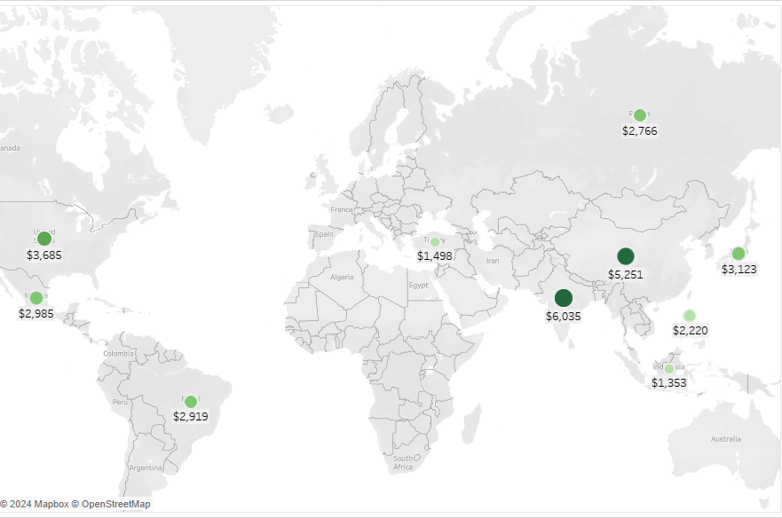
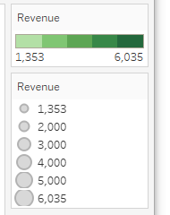
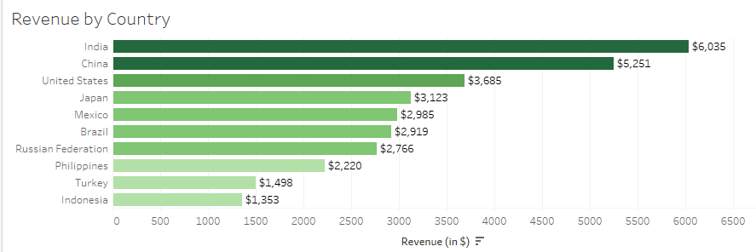
Sales Figures vary between geographic regions
India and China make up 35% of the total revenue from the top 10 countries

Slide 10
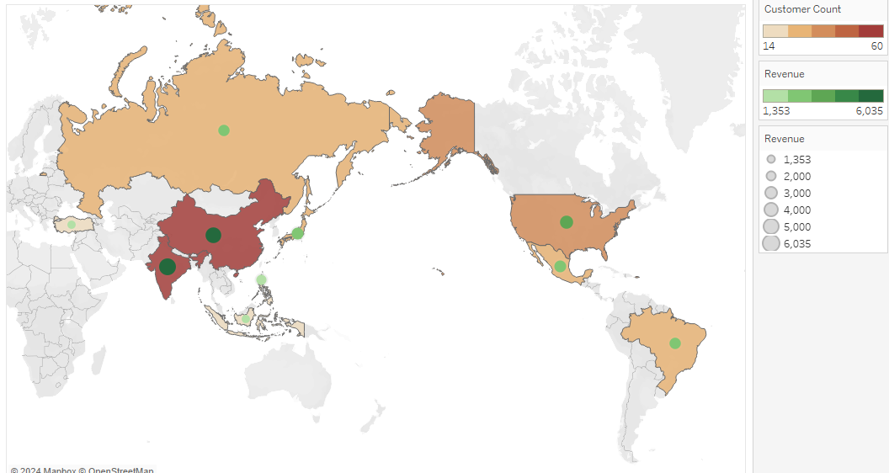
Conclusion
Top 10 countries in terms of both revenue and number of customers
India 5. Mexico 8. Philippines
China 6. Brazil 9. Turkey
United States 7. Russian Federation 10. Indonesia
Japan

Slide 11
Conclusion
Top 10 countries in terms of both revenue and number of customers
India 5. Mexico 8. Philippines
China 6. Brazil 9. Turkey
United States 7. Russian Federation 10. Indonesia
Japan

Slide 12
Recommendations
Concentrate marketing on the following:
Top 10 countries in revenue and customer number in 2006
Top 5 genres that grossed over $4 million in 2006
Keep high-value customers by offering them loyalty programs;
Attract new customers by offering them first-time discounts
Vary cost and rental duration of movie according to demand
High-demand movies should cost more and
have less rental duration
Survey viewers to determine the type of movies that they like
(genre, rating, film length, etc.)

Slide 13
Thank you!
Questions?
Please Contact:
Bmorrison@gmail.com

